Slide 1
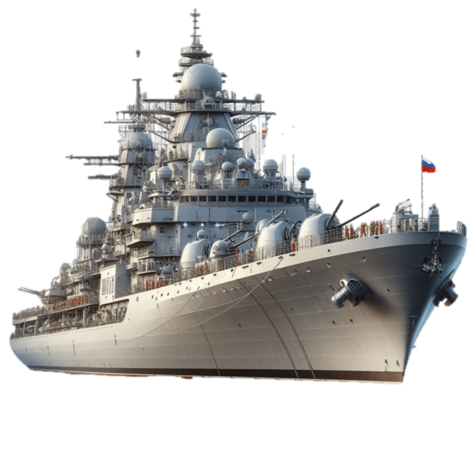
Strategic Convergence and legal Cooperation in Maritime Security Between India And Russia
Manish Kumar Singh
Assistant Director (maritime Studies)
Rashtriya Raksha University

Slide 2
Why this Topic? SAGAR to MAHASAGAR
India has articulated a comprehensive maritime vision through SAGAR – Security and Growth for All in the Region, first outlined by PM Narendra Modi in Mauritius in 2015 and reiterated on its 10th anniversary in 2025.
In 2025, India expanded this to MAHASAGAR – Mutual and Holistic Advancement for Security and Growth Across Regions, signaling a shift from a purely Indian Ocean focus to a broader global maritime outlook.
Russia, as a major Arctic maritime power, has prioritized the Northern Sea Route (NSR) and its Arctic zone as strategic transport and security corridors.
India–Russia cooperation now increasingly connects the Indian Ocean, Far East and Arctic, making “Indian Ocean–Arctic linkages” a real strategic and legal agenda rather than a theoretical concept.

Slide 3

Evolution of the India–Russia Strategic Partnership
2000: India and Russia declared a “Strategic Partnership”, raised in 2010 to a “Special and Privileged Strategic Partnership” (MEA “India–Russia Relations” briefs and Annual Reports).
2013: Joint Statement “Deepening the Strategic Partnership for Global Peace and Stability” emphasized close coordination on global peace, security and stability.
2014: “Druzhba-Dosti: A Vision for Strengthening the Indian-Russian Partnership over the next decade” highlighted long-term cooperation, including in energy and high-technology sectors, laying foundations for later Arctic energy and maritime projects.
2016: At Goa, leaders adopted “Partnership for Global Peace and Stability”, reinforcing joint responsibility for global and regional security.
2021: 21st Annual Summit produced “India-Russia Partnership for Peace, Progress and Prosperity” with dedicated sections on the Indo-Pacific, maritime security, connectivity corridors and the Arctic.
2024: 22nd Annual Summit Joint Statement further stressed cooperation in the Russian Far East, Arctic and maritime connectivity (INSTC and Eastern Maritime Corridor).

Slide 4
Maritime Security in the Indian Ocean: India–Russia Naval Cooperation
Since 2003, Exercise INDRA NAVY has been the bilateral maritime exercise between the Indian Navy and the Russian Navy, aimed at inter-operability and maritime security operations.
Exercises include anti-submarine warfare, air-defence, maritime interdiction, search & rescue, and drills against piracy, terrorism and smuggling—explicitly framed as maritime security operations.
INDRA NAVY-21 (Baltic Sea) and subsequent editions strengthened blue-water coordination; the 12th edition in 2021 was held in the Baltic, linking IOR experience to high-latitude operations.
INDRA NAVY-25 (14th edition) in March–April 2025 off Chennai/Bay of Bengal further reinforced operational cooperation, during a period of heightened global maritime tensions.

Slide 5
Connecting through Routes
The international north–south transport corridor (INSTC) is a multi-modal network (sea–rail–road) linking Indian ports to Russia via Iran and the Caspian; India, Iran and Russia signed the agreement in 2000.
Indian official fact-sheets describe INSTC as reducing transit time and cost between India and Russia, complementing maritime routes..
Russia’s government documents call for diversification of logistics corridors, specifically including the NSR and southern routes, of which INSTC is a core component.
At the 2019 eastern economic forum (EEF), India and Russia first envisioned a Chennai–Vladivostok maritime corridor (eastern maritime corridor) connecting the bay of Bengal with Russia's far east..
Ministry of ports, shipping & waterways (MoPSW) notes that the eastern maritime corridor and northern sea route are being jointly developed as complementary routes linking India to the Russian far east and arctic.
By 2024, Indian ministers publicly stated that the Chennai–Vladivostok EMC has become operational, reducing distance and time compared to the traditional Mumbai–St. Petersburg route.

Slide 6
India–Russia Arctic Convergence
The 2014 “Druzhba-Dosti” Joint Statement welcomed Indian participation in Russian energy projects, including offshore and Arctic shelf hydrocarbons, signaling early interest in Arctic cooperation.
The 2018 and 2019 summit documents and EEF remarks reiterated Indian interest in participating in Arctic LNG and hydrocarbon projects and in the development of the Russian Far East, including ports like Vladivostok.
The 2021 “Partnership for Peace, Progress and Prosperity” Joint Statement noted increased cooperation in Far East and Arctic projects, including energy, shipping and investments.
In July 2024, India and Russia adopted a “Programme of India–Russia cooperation in trade, economic and investment spheres in the Russian Far East for 2024–2029 and in the Arctic zone of the Russian Federation”, a formal framework for deeper engagement.

Slide 7
Multilateral Cooperation: IOR to Arctic
In the Indian Ocean, India and Russia coordinate in UN-mandated anti-piracy efforts, support freedom of navigation and share concerns about non-traditional threats, as reflected in UNSC debates and MEA statements.
Within BRICS and SCO, summit declarations and leaders’ statements often mention maritime security, connectivity corridors, and support for UNCLOS, where India and Russia generally align.
In polar governance, India’s Arctic Policy commits to playing a responsible role as an Observer in the Arctic Council; Russia’s Arctic documents emphasize science, indigenous welfare and environmental protection—areas where Indian scientific expertise can complement Russian capacities.

Slide 8
Opportunities and Way Forward
Institutionalize Legal Dialogue: Create an India–Russia Working Group on Maritime Law and Arctic Governance, nested under the Inter-Governmental Commission, to discuss NSR regulations, environmental standards, SAR, and liability regimes.
Joint Naval & Coast Guard Activities: Expand INDRA NAVY to include Arctic-relevant drills (cold-weather SAR, ice navigation table-tops) and consider coast guard MoUs on search and rescue, HADR and pollution response.
Connectivity Corridors Integration: Legally and operationally integrate INSTC, EMC and NSR into a coherent set of corridors, with joint studies on customs, port state control, and digital documentation.
Science–Law Interface: To continuously engage into science, law, humanities and cultural research between Indian and Russia, including polar research to co-publish India–Russia studies on Arctic climate, shipping impacts and legal implications, feeding into Arctic Council working groups.

Slide 9
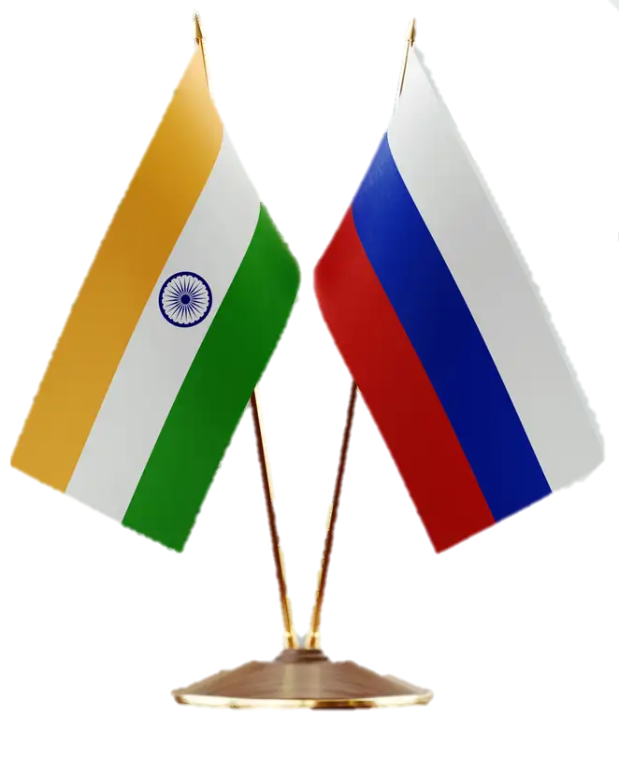
Thank you!
Manish Singh, assistant Director (Maritime Studies)
ad.vco-ms@rru.ac.in | Rashtriya Raksha University

