Slide 1
The future of geopolitics in the Arctic The contribution of the proposed Pyramiden International Research Station (PIRS) to cooperation and pragmatism
Professor Tina Soliman-Hunter
Professor of Energy and Resources Law, Macquarie University
Presentation at IECCA Conference, Moscow, 24 November 2025

Slide 2
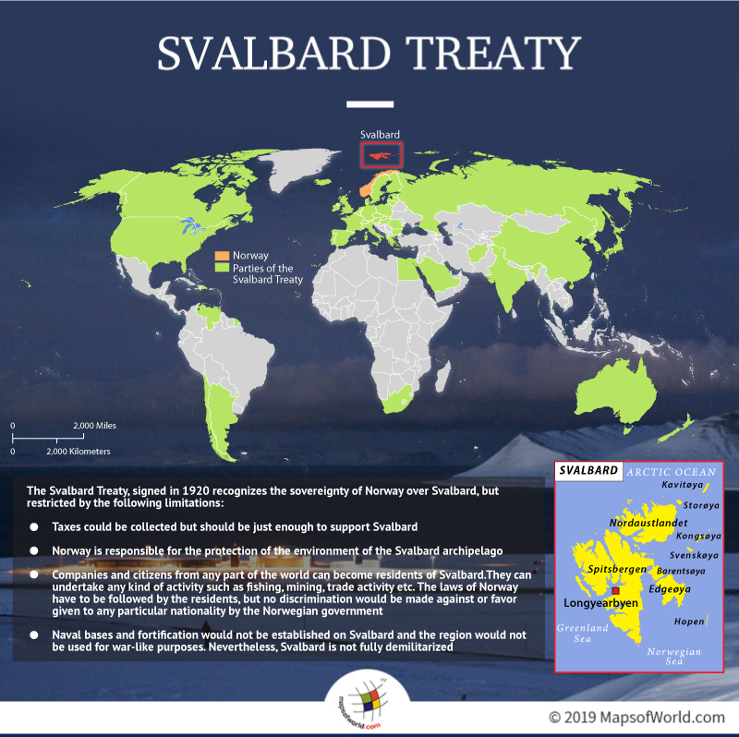
The Svalbard Treaty
History
Treaty and unique nature of the treaty arrangements
Treaty negotiation sans Russia
Role of Norway
Importance of signatories
People and movements
Military presence
Ultimate demilitarized zone?
Notes:
Norway’s, sovereignty over the island was not absolute, but had limitations. These were – taxes could be collected but should be just enough to support Svalbard. Norway is responsible for the protection of the environment of the archipelago. Companies and citizens from any part of the world can become residents of Svalbard. They can undertake any kind of activity such as fishing, mining, trade activity etc. The laws of Norway have to be followed by the residents, but no discrimination would be made against or favor given to any particular nationality by the Norwegian government. Naval bases and fortification would not be established on Svalbard and the region would not be used for war-like purposes. Nevertheless, Svalbard is not fully demilitarized. Following the establishment of Norwegian authority over the region, the name was changed from Spitsbergen to Svalbard in the 1920s. Over the years, many other nations became signatories to the treaties and as of 2018, the Svalbard Treaty has 46 participants.
establishes the right for residents of signatory nations to reside on the archipelago without requiring visas or work permits. This non-discriminatory access is a cornerstone of the Treaty, creating a distinctive legal and political environment. Although there is no dispute that Norway has sovereignty, as set out Article 1 of the Treaty, the exercise of such sovereign rights has been the subject of ongoing discussion.
As the sovereign power, Norway seeks to assert control and regulate activities. Given that Russia was not at the Treaty negotiations, there was concern that the then Soviet Union would challenge the Treaty, ‘given their geographic proximity to the area and claims of historic use’. However, in 1924 the USSR unconditionally recognised Norwegian Sovereignty over the Archipelago, acceding to the Treaty in 1935. As noted by Jorgensen, as sovereign,
Norway regulates all activities in the archipelago, but multiple countries have their own nationals and companies operating there. Over time – as Norway has implemented stricter environmental regulations, increased coordination of other countries’ research activities, and limited certain types of activities that do not fall under the scope of the 1920 treaty – the outcry from treaty signatories over specific issues and interests has grown.
Todorov, Andrey. 2020. ‘Russia in Maritime Areas off Spitsbergen (Svalbard): Is It Worth
Opening the Pandora’s Box?’ Marine Policy 122 (December). https://doi.org/10.1016/j.marpol.2020.104264
Anne-Kristin Jørgensen and Andreas Østhagen. ‘Norges Vern Av Suverene Rettigheter Rundt Svalbard: Russiske Persepsjoner Og Reaksjoner’(2020) 78 (2) Internasjonal Politikk 167–92

Slide 3
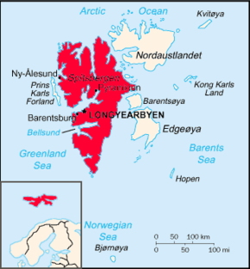
Svalbard and its geopolitical importance
Location and geopolitical importance
Russian Northern Fleet
Research facilities
Longyearbyen
Ny Ålesund
Russian settlements
Pyramiden
Barentsburg
Demilitarized?
A9 of Svalbard Treaty
SvalSat (KSAT)
Civilian vs military infrastructure
Importance as part of NSR
Barentsburg – operational plus research
Notes:
Ny Ålesund is a research station.
Pyramiden is abandoned Soviet settlement
Barentsberg - Russian research center in Barentsburg includes a satellite ground station and is working with international partners like China on future projects
, Pyramiden, abounded in 1998 when coal mining operations ceased. Russia has continued to challenge Norway’s use of Svalbard for military purposes. Despite Article 9 of the Treaty prohibiting military bases and fortifications, Svalbard is not formally designated as a demilitarized zone. Regularly the Norwegian Coast Guard (‘Kystvakt’) docks at Longyearbyen for ‘resupply purposes’, with Norwegian Navy frigates also maintaining a presence, ostensibly to highlight Norwegian sovereignty and capability in the region. Russia has challenged such use of Svalbard by Norway, claiming it is for ‘military purposes’ and thus in breach of Article 9 of the Treaty. Indeed, in November 2021, Russia accused Norway seeking to include Svalbard in its sphere of national military development, including the receiving of reinforcements from NATO allies. Similarly Russia argued in October 2022 that Norway’s actions were aimed at ‘consolidating Spitzbergen within its sphere of military activity’.
Andeas Østhagen, ‘Svalbard: the worrying geopolitics of an Arctic Archipelago’ (2023) 19(2) Canadian Naval Review 9-14, 10
Østhagen , ibid, 11
Embassy of the Russian Federation in Norway (2020, February 4). Press release on Foreign Minister Sergey Lavrov’s message to Norwegian Foreign Minister Ine Eriksen Soreide on the occasion of the 100th anniversary of the Spitsbergen Treaty [Press release]. https://norway.mid.ru/en/embassy/press-centre/
news/press_release_on_foreign_minister_sergey_lavrov_s_message_to_norwegian_foreign_minister_ine_eriksen_/
Russian Ministry of Foreign Affairs. (2022, October 6). Kommentarii ofitsial’nogo predstavitel’ya MID Rossii M. V. Zakharovoy v svyazi susileniem norvezhskogo voennogo prisutstviya na arkhipelage Shpitsbergen [Comments from the official representative of the Russian Ministry of Foreign Affairs, M. V. Zakharova, in connection with the strengthening of Norwegian military activity on the Spitsbergen archipelago]. https://mid.ru/ru/foreign_policy/news/1832770/

Slide 4
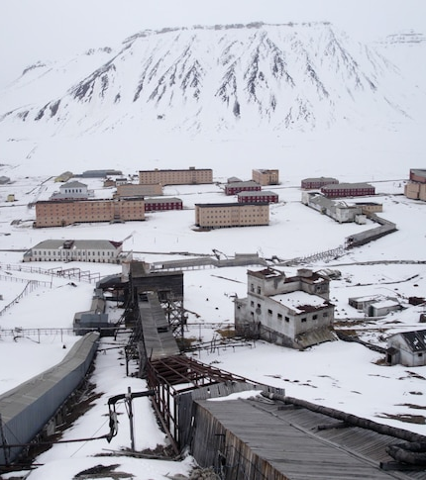
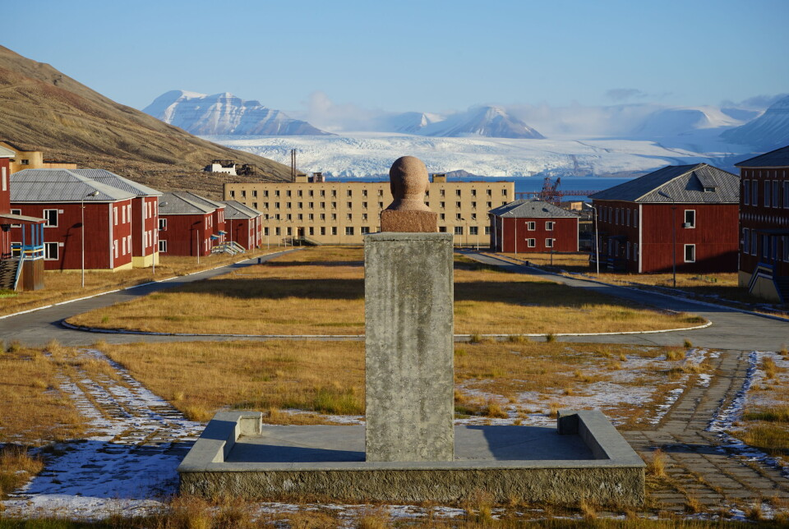
Russian facilities at Pyramiden
Some facilities already but abandoned since 1998 – usefulness?
roads
Re-establish essential services
Impact of permafrost on buildings?
Energy generation?

Slide 5
Possible research facilities
Discussion around the establishment of the Pyramiden Research Station (PRS) at the IV International Scientific and Practical Conference “Security of the Arctic Borders: Ecology, History, Images of the Future in October 2023
New Pyramiden International Research Station:
a new international research station in Pyramiden
Supported at BRICs researchers, in line with Russian Foreign Policy pivot
Support from Turkey also
support from the state-owned company Trust Arctikugol
Tambov State University
Moscow State Institute of International Relations (MGIMO)
Russian State University for the Humanities (RSUH)
Precedent in establish international research station – Ny Ålesund
shared resources for marine ecology, physiology, biochemistry and physical sciences

Slide 6
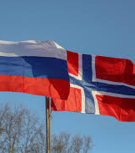
Contribution of PIRS to regional and global geopolitics
Demonstration of desire to cooperate with Norway
Pragmatism and functionalism
Cooperation not conflict
Demonstrates non-military intentions
Shared space with NATO member
Ameliorates declaration of Norway as ‘very unfriendly’
Segregates activities on Svalbard from rest of world – a special area for geopolitical tolerance

Slide 7
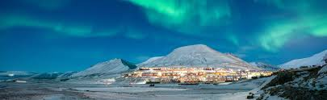
Concluding remarks
Precedence for International Scientific Research Centre – Ny Ålesund
Abandoned Pyramiden settlement is ideal location – will revive the Russian claim over town
Supports existing research and activities in Barentsburg
Supports Russian Foreign Policy
Allows Russia to push back on Norwegian administration/ sovereignty over Svalbard whilst maintaining ‘friendly’ relations

Slide 8
Thank you!
Tina.solimanhunter@mq.edu.au

