Slide 1
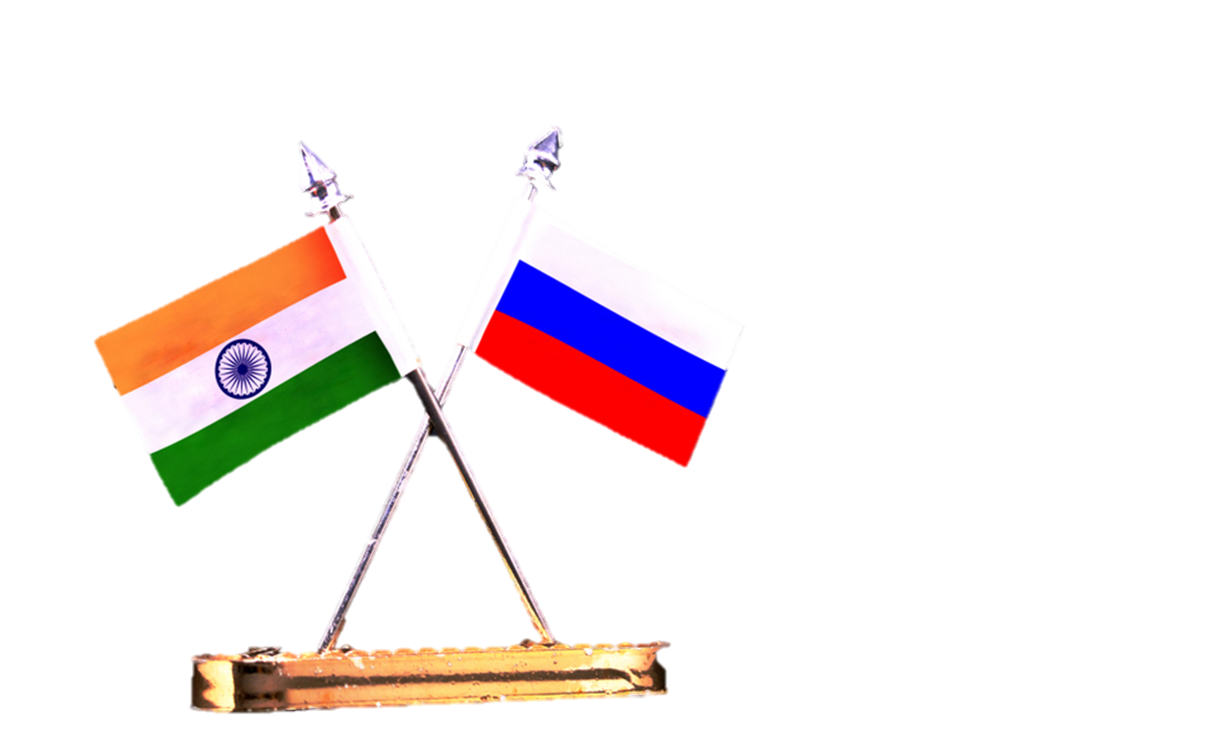
India-Russia Sustainable Polar Strategy in a Multipolar World
(Collaborating for Climate Resilience, Development, and Security)
Annual Meeting of The International Expert Council on Cooperation in The Arctic (IECCA)
“Scientific Diplomacy As A Tool For Maintaining Dialogues In The Arctic”
(29 November, 2024)
Manish Kumar Singh
Research Officer
Rashtriya Raksha University
E-mail: ro2.vco@rru.ac.in

Slide 2
Introduction and Key Priorities
India's Arctic Policy focuses on harmonizing polar research for sustainability.
Russia's Arctic Strategy emphasizes development and Arctic security.
India's Priorities:
Science & Research: Arctic expeditions and robust climate studies.
Climate Action: Monitoring Arctic melting impacts on Himalayan glaciers.
Governance: Observer role in the Arctic Council.
Russia's Priorities:
Infrastructure: Developing the Northern Sea Route (NSR).
Resource Management: Sustainable Arctic hydrocarbons.
Security: Strategic protection of Arctic territories.
Notes:
India's Arctic Policy, titled "India and the Arctic: Building a Partnership for Sustainable Development," was released in March 2022. This policy outlines six key pillars to guide India's engagement in the Arctic region:
1. Science and Research
2. Climate and Environmental Protection
3. Economic and Human Development
4. Transportation and Connectivity
5. Governance and International Cooperation
6. National Capacity Building
Arctic Expeditions: India has been actively conducting scientific expeditions to the Arctic since 2007. As of November 2024, India has successfully conducted 14 Arctic expeditions. The 14th Indian Arctic Expedition took place during 2023–2024.
India currently operates two key research facilities in the Arctic:
1. Himadri Research Station
Location: Ny-Ålesund, Svalbard, Norway
Established: 2008
Focus Areas:
- Monitoring and assessing climate change impacts.
- Atmospheric sciences, including aerosols and pollutants.
- Biological sciences, including Arctic flora and fauna studies.
- Glaciological and geological research.
Significance: Himadri is India's primary research base in the Arctic and plays a vital role in facilitating year-round studies.
2. IndARC (Underwater Moored Observatory)
Location: Kongsfjorden fjord, Svalbard, Norway
Established: 2014
Focus Areas:
- Monitoring subsurface parameters related to Arctic fjord systems.
- Studying the impact of warming Arctic waters on marine ecosystems and the global climate system.
Significance: IndARC supports studies related to oceanographic and environmental parameters in Arctic waters.
These stations are managed and coordinated by the National Centre for Polar and Ocean Research (NCPOR) under the Ministry of Earth Sciences, Government of India.
Governance: Observer Role in the Arctic Council
- Observer Status: India was granted Observer status in the Arctic Council in 2013. India, engages in discussions and initiaties related to sustainable development, environmental protection and scientific research in the Arctic.
RUSSIA's Priorities:
1. Infrastructure: Northern Sea Route (NSR)
- Strategic shipping route linking Europe and Asia.
- Development of Arctic ports (e.g., Murmansk, Arkhangelsk).
- World's largest icebreaker fleet (Approx. 50 Polar Vessels), including nuclear-powered vessels.
- Target: 80 million tons of NSR cargo traffic by 2024.
2. Resource Management: Arctic Hydrocarbons.
- Holds 13% of global undiscovered oil and 30% of natural gas. India imported an average of 1.7 million barrels per day (bpd) of crude oil from Russia during the January-September 2024 period. This made Russia the largest supplier of crude oil to India during that time.
3. Focus on environmental regulations and advanced extraction technologies.
4. Diversification of energy exports, particularly toward Asian markets.
5. Security: Strategic Arctic Defense
6. Northern Fleet, headquartered in Severomorsk: Russia's primary Arctic naval force.
7. Goals: Defend borders, protect economic interests, and deter adversaries.
8. Balanced military buildup with international cooperation for stability.

Slide 3
Strategic Partnerships, Joint Initiatives & Energy Cooperation
Strategic Partnerships:
BRICS Summit Participation: In October 2024, India participated in the BRICS summit hosted by Russia, reinforcing its commitment to multilateral cooperation and shared global objectives.
Joint Arctic Research:
Studies on melting ice impacts, climate change and biodiversity conservation.
Technology exchange: Satellite remote sensing, Cryosphere modelling to monitor and analyze Arctic environmental changes.
12+ joint studies; $50M allocated (2020–2024).
Energy Cooperation:
Hydrocarbon exploration: Collaboration on Sakhalin and Vankor projects.
Green energy: Renewable pilots in Arctic zones, decarbonization.
Notes:
Energy Cooperation
Hydrocarbon Exploration:
Indian companies, such as ONGC Videsh, have invested in Russian oil and gas projects, including stakes in the Sakhalin-1 and Vankor fields.
These investments aim to secure energy resources and enhance energy security for India.

Slide 4
Transport, Security and Development
Transport and Connectivity:
Key Projects: International North-South Transport Corridor (15 days faster), Vladivostok-Chennai Maritime Corridor (40% faster).
Integration of Arctic shipping expertise.
Defense and Security:
Building ice-class vessels, naval exercises.
Data sharing: Real-time navigation and climate alerts.
Human and Economic Development:
Blue economy initiatives and Arctic seed vaults.
Indigenous knowledge exchange between Arctic and Himalayan communities.
Notes:
Key Projects:
International North-South Transport Corridor (INSTC): A multimodal network connecting India to Russia via Iran and Central Asia, reducing transit time by approximately 15 days compared to traditional routes.
Chennai–Vladivostok Maritime Corridor: A proposed sea route covering about 5,600 nautical miles, aimed at increasing bilateral trade between India and Russia.
Ice-Class Vessel Construction:
India is considering building ice-class vessels in collaboration with Russia to strengthen its presence in polar regions.
INDRA NAVY Exercises (Biennial Exercise):
The 12th edition was conducted in August 2021 in the Baltic Sea.
The 13th edition took place in November 2023 in the Bay of Bengal.
Maritime Partnership Exercise (MPX):
In July 2024, INS Tabar participated in the 328th Russian Navy Day parade in St. Petersburg. Following this, a Maritime Partnership Exercise was conducted with the Russian Navy Ship Soobrazitelny on July 30, 2024.
Human and Economic Development
Blue Economy Initiatives:
India is focusing on sustainable use of ocean resources, including fisheries and marine biotechnology, in collaboration with Arctic nations.
Arctic Seed Vaults:
India has contributed to the Svalbard Global Seed Vault, ensuring the preservation of diverse crop varieties.
Indigenous Knowledge Exchange:
Efforts are underway to facilitate knowledge exchange between Arctic indigenous communities and Himalayan communities, focusing on sustainable living practices and climate resilience.

Slide 5
Science, Education and Way Forward
Science and Education:
Academic collaborations on Arctic-Himalayan ecosystems.
Training and research initiatives: Arctic navigation and logistics.
Way Forward:
Academic Collaborations.
Capacity Building Programme.
Boost Arctic governance in multilateral forums.
Global Leadership: Promote equitable and sustainable Arctic development.
Notes:
Memorandum of Understanding (MoU):
Signed between NCPOR (India) and Arctic and Antarctic Research Institute (Russia) during the 22nd India-Russia Annual Summit on July 9, 2024.
Focus: Strengthen cooperation in polar research and logistics.
Rashtriya Raksha University, An Institution of National Importance, under the aegis of Ministry of Home Affairs, Government of India, made representation at the recently organized BRICS Universities Rectors Forum, From October 17-18, 2024 held at Lomonosov Moscow State University, Russia.
Also, RRU recently organized “International Workshop on India’s Polar Region Policy Towards Building Partnerships for Sustainable Development” from 12-13 March 2024. Whereunder, few of the key polar experts joined remotely connecting with the global community, sharing their expertise and insights on the latest research contributions in the Arctic regions.
Indo-Russian Education Summit 2024: Held in New Delhi from April 11 to 13, 2024, this summit marked a significant milestone in bilateral educational relations. Over 60 Russian universities participated, leading to the establishment of a research hub at the University of Delhi in collaboration with the Higher School of Economics (HSE) in Moscow. The summit facilitated discussions on joint programs in education, science, innovative technologies, and professional training.

Slide 6
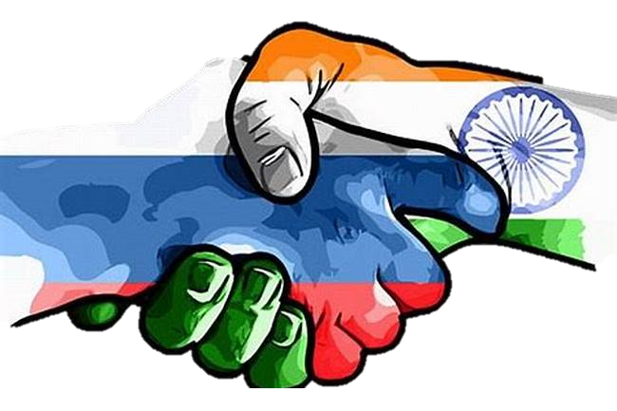
Thank You!
Jai Hind!
For question/feedback/comment(s): manishkumar.singh@rru.ac.in ; ro2.vco@rru.ac.in

