Slide 1
The Role of Scientific Diplomacy in Managing the Arctic
GUO Peiqing （郭培清）
School of International Affairs and Public Administration
29 November 2024
For RUDN University

Slide 2
Content
Ⅰ. The international Arctic cooperation suspended
Ⅱ. BRICS Arctic cooperation: talk but no action
Ⅲ. What causes this scenario?
Ⅳ. My suggestion

Slide 3
Ⅰ. The international Arctic cooperation suspended
Arctic suspended after SMO broke in 2022 February. The Arctic is undergoing NATO-ization after Sweden and Finland joining NATO.
The International Arctic research cooperation frozen and seriously damaged the common interest of human being.
A current of sanction including science boycott floods to Russia.
-The Arctic Circle Forum and the Arctic Frontier rejected Russia's participation
-During Arctic Science Summit Week (ASSW) 2022 Tromsso Meeting, Norway refused Russia's participation
………………

Slide 4
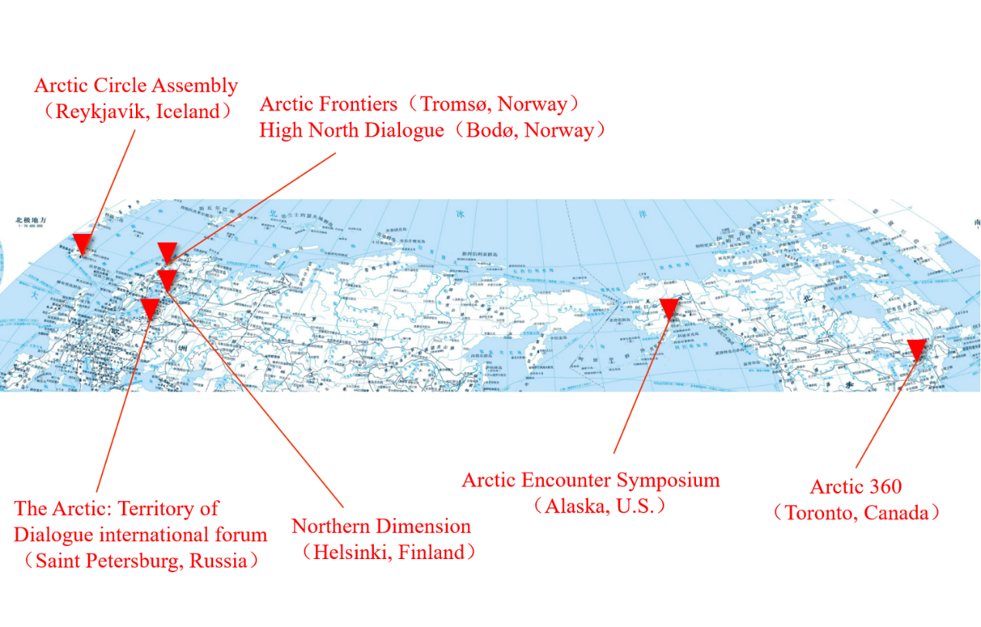
Most of Arctic conference platforms refuses Russia,
or even some foreign participants suffered punishments by their authorities
The Arctic: Territory of Dialogue international forum has beome a Russian domestic forum.

Slide 5
Ⅱ. BRICS Arctic cooperation: talk but no action
-Russia turns to “friendly countries”, seeking to strengthen ties with non-Western countries to ease the multiple dilemmas of isolation.
BRICS Working Group on Marine and Polar Science was set up in 2018, and has had 6 times meetings by now.
Natalia Golubeva, Division of Science and Technology Organization and Coordination, Russian Ministry of Science and Higher Education, said that Russia is ready to actively carry out maritime and polar research and cooperation with BRICS countries.

Slide 6
Ⅱ. BRICS Arctic cooperation: talk but no action
MEMORANDUM OF UNDERSTANDING ON COOPERATION IN SCIENCE, TECHNOLOGY AND INNOVATION BETWEEN
THE GOVERNMENTS of BRICS…in 2015
19 priority areas of cooperation have been identified, including Marine and polar sciences.
Moscow puts much effort to push for BRICS Science Center at Svalbard Islands.
All these are in the air but no action.

Slide 7
Ⅲ. What causes this scenario?
1. Structure limitations
Neither BRICS Working Group on Marine and Polar Science nor BRICS Ministerial Conference on Science, Technology and Innovation has practical implementation rules and operational procedures. Empty structure!
2. Russia is the only Arctic country in the BRICS, and most of the other BRICS members participation in Arctic scientific cooperation mainly rely on the bilateral cooperation with Russia.
Russia-centered structure make the cooperation more fragile.

Slide 8
Ⅲ. What causes this scenario?
3. Norway’s objection and intimidation from West major powers
Norway has insisted on exclusive jurisdiction in Spitzerburgen Islands in the past years, and some BRICS states faces threat from the West, do not dare to cooperate with Russia.
4. Cognitive differences
In Arctic cooperation, the BRICS countries face with the challenges of differences in strategic understanding and positioning and lack of political mutual trust, resulting in complex and difficult to unify cooperation intentions.

Slide 9
Ⅲ. What causes this scenario?
5. Group confrontations
The sanctions, issued by the American government on October 30, 2024, target nearly 400 entities and individuals, including BRICS members and partners such as India, Malaysia, Thailand, Turkey and the United Arab Emirates.

Slide 10
Ⅳ. My suggestion
Russian unilateral science opening up to the West
Cancel any reciprocal retaliation policy.
Initiate science cooperation project to involve in the West institutes and individuals, disintegrate their science sanction policy, and open the scientific facilities, data, and other resources to foreign sicentists.
Not mutual but unilateral!
Russia will not only break the blockade, but will address the critical problem plaguing Russia. Funding!

Slide 11
Ⅳ. My suggestion
2. Get involved in the International Polar Year 2032–33
Russia’s territory almost is half of Arctic region, and it is impractical to exclude Russia from 5th IPY.
Anybody who tries to exclude Russia from this great project, will face collective objection around the world.
Far way and too earlier from 5th IPY? Making and showcasing expectation!

Slide 12
Ⅳ. My suggestion
There are always more ways than difficulties unless you give yourselves up.
Where you can meet the wisdom? China-Russia Arctic Workshop!
14th China-Russia Arctic Workshop will be held in SPSU, 25-27 May 2025.
4th Arctic School will open at RANEPA (The Russian Presidential Academy of National Economy and Public Administration), 23-27 May 2025.

Slide 13
Thanks for your attention！

