Slide 1
2024
Exploration of the Function of Environmental Service Cooperation in Regional Governance
演讲人：王海文
时间：2024.11

Slide 2
Contents
01
02
03
04
The current
state of the
world
environment
Function
exploration
Summary
and
Suggestions
China's efforts
1. Extreme weather
2. The urgency of
environmental protection
3. The task of carbon
neutrality
1. What has China done
2. Contributions made to
environmental service trade
3. Data
1. How can we promote cooperation
in environmental services
2. Key issues in regional governance
3. Strengthen the functional advantages
of regional governance

Slide 3
The current state of
the world environment
01
It is urgent to take action to address climate change.

Slide 4
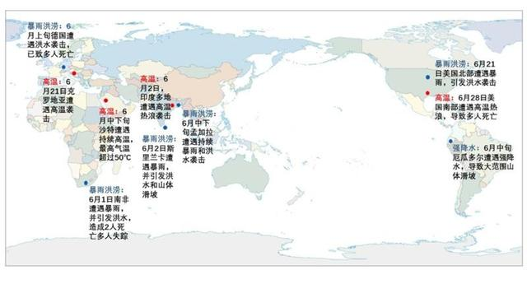
1
Extreme Weather
On July 18th ，2024, according to the Sixth Assessment Report (AR6) of the Intergovernmental Panel on Climate Change (IPCC), global warming has been occurring at an unprecedented rate in the past 2000 years over the past 50 years. Continuous warming exacerbates the instability of the climate system, leading to an increase and intensification of extreme weather and climate events, with a wider range of impacts.
According to data from the World Meteorological Organization (WMO):
1. Global inflation: From 1880 to 2020, the average annual global inflation was about 1.2 °C.
2. Increase in extreme climate events: In 2023, over 20 countries worldwide experienced extreme drought events, affecting the lives of hundreds of millions of people.
3. Heatwave: The number of heatwave days worldwide has increased by approximately 50% in the past 50 years.
A schematic diagram of major catastrophic weather events worldwide in June 2024. Image source: Central Meteorological Observatory

Slide 5
1
Extreme Weather
The Blue Book on Climate Change in China (2024) shows that as a sensitive and significantly affected area of global climate change, from the perspective of long-term changes in extreme events, the average number of in China increases by 6.7 days every 10 years. The number of annual cumulative rainstorm days per year (daily precipitation ≥ 50mm) station days increases by 4.1% every 10 years.
According to a report released by the World Meteorological Organization in June, there is an 80% chance that the global annual average temperature will temporarily exceed pre industrial levels by 1.5 °C for at least one year in the next five years. This has sounded an alarm globally, and action to address climate change is urgently needed.

Slide 6
2
The urgency of environmental protection
1. Reduce greenhouse gas emissions:
Recently, countries have put forward goals to weaken climate change by reducing greenhouse gas emissions. According to the International Energy Agency (IEA), the global energy industry's carbon emissions reached 3.15 billion tons in 2020, but gradually showed a downward trend driven by renewable energy.
2. Forest protection and afforestation:
Forests are important "carbon sinks" on Earth, absorbing and storing large amounts of groundwater. According to the United Nations Environment Programme (UNEP), 100000 forests are cut down globally every year, exacerbating greenhouse gas emissions. Many countries and regions have begun implementing large-scale afforestation programs to restore forest cover.
2. Avoid pollution:
Plastic pollution has become a part of global environmental issues. According to a report by the International Plastic Pollution Coalition, over 8 million tons of plastic enter the ocean each year, posing a threat to marine ecosystems and the human food chain. Governments and businesses around the world are taking the lead in addressing this challenge by limiting the total use of plastic, promoting plastic recycling, and implementing circular economy measures.

Slide 7
3
The task of carbon neutrality
The Paris Agreement explicitly controls the global average temperature rise from before the Industrial Revolution to no more than 2 ℃ and strives to achieve 1.5 ℃. Research in the scientific community shows that a temperature increase of over 1.5 ° C may lead to more severe climate change impacts and extreme weather, with every 0.1 ° C increase being of significant importance. To address climate change and promote the reduction of greenhouse gases, mainly carbon dioxide, more than 100 countries around the world have proposed carbon neutrality targets. Among them, China aims to achieve carbon peak before 2030 and carbon neutrality before 2060.

Slide 8
02
China's efforts
Lucid waters and lush mountains are invaluable assets. With the continuous strengthening of the strategic position of ecological civilization construction and the gradual deepening of environmental awareness, production and lifestyle are also undergoing profound changes.

Slide 9
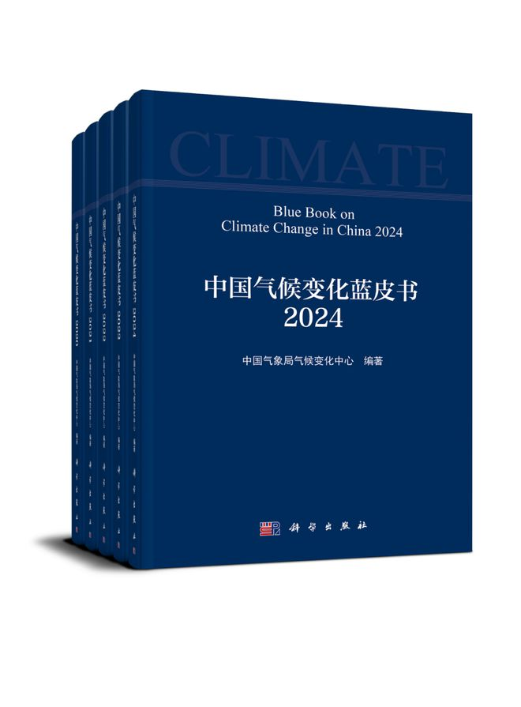
1
What has China done
In recent years, China has made great efforts in ecological environment governance, and a set of data shows the truth. As of now, the national forest coverage rate has exceeded 24%, making the country with the fastest growth in forest resources in the world.
Fifty-two integrated protection and restoration projects for mountains, waters, forests, fields, lakes, grasses, and sands have been implemented, with a cumulative restoration and treatment area of over 100 million acres.
The "Chinese Landscape Project" has been successfully selected as one of the first batch of the world's top ten ecological restoration flagship projects by the United Nations.
Establish a "National Park-Nature Reserve-Nature Park" in-situ biodiversity conservation network.
Promoting the protection and restoration of typical marine ecosystems, the area of mangrove forests has increased to 438000 acres, becoming one of the few countries in the world with a net increase in mangrove forest area.

Slide 10
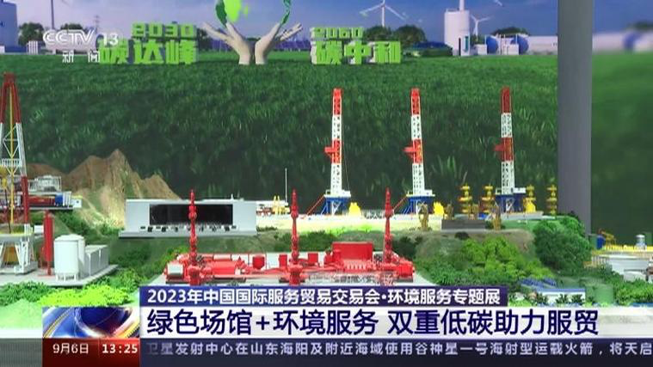
2
China's contribution to environmental service trade
In 2023, China's photovoltaic installed capacity ranked first in the world for 10 consecutive years, and its newly added total installed capacity ranked first in the world for 8 consecutive years.As of the end of 2023, the cumulative trading volume of China's carbon emission trading market is about 440 million tons, covering an annual carbon dioxide emissions of about 5.1 billion tons.
In 2024, China will carry out the "Ten Actions to Peak Carbon Emissions", enhance its ability to calculate and verify carbon emissions, deepen the energy revolution, and strengthen the construction of large-scale wind and photovoltaic bases and transmission channels, which will be included in the government work report. The production of new energy vehicles increased by 34.3% year-on-year, while the production of supporting products such as charging piles and lithium-ion power batteries for automobiles increased by 25.4% and 16.5% respectively.

Slide 11
03
Function exploration
Promoting cooperation in environmental services and regional governance is a key path to addressing cross regional environmental issues and achieving sustainable development.

Slide 12
1
How can we promote cooperation in environmental services
Establish a mechanism for harmonious governance of regional environment
Sharing environmental information and technology
Strengthening international and regional environmental cooperation
Method: By signing regional environmental agreements or framework agreements, clarify the responsibilities and obligations of all parties involved, and coordinate cross regional environmental governance actions.
Case study: China's "Beijing Tianjin Hebei Air Pollution Prevention and Control Cooperation Mechanism" has achieved unified monitoring, joint law enforcement, and data sharing among regions, significantly improving regional air quality.
Method: Establish a cross regional information sharing platform to promote the exchange of environmental data, monitoring technology, and governance experience.
Function: Sharing information improves governance efficiency and reduces duplicate entrepreneurship; The promotion of advanced technology has accelerated the resolution of environmental issues.
Case: The European Union has promoted cooperation between products by sharing environmental information such as air quality and water resources through the European Environmental Information and Observation Network (EIONET).
Method: Participate in or lead regional environmental cooperation organizations, and use international platforms to regulate cross-border environmental governance.
Function: International cooperation can solve regional environmental problems that cannot be independently solved by a single country.
Case: The Mekong River Commission (MRC) coordinated cooperation among Mekong River basin countries in water resource management and ecological protection.

Slide 13
2
Key issues in regional governance
Problem: Environmental issues such as water pollution and air pollution often involve multiple regions, and the sources of pollution are difficult to remedy. Villagers are prone to shirking responsibility.
Measures: Clear allocation of responsibilities through legal agreements, while introducing third-party monitoring and evaluation mechanisms.
Problem: There are significant differences in economic development levels between regions, and some areas may prioritize economic development over tariffs.
Response measures: Introduce an ecological compensation mechanism and help economically underdeveloped areas achieve green transformation through policy guidance and financial support.
Difficult to define responsibilities for cross-border environmental issues
The contradiction between economic development and environmental protection
Problem: Differences in environmental policies and technical standards in different regions may lead to uneven governance effects.
Response measures: Establish regional unified environmental governance standards and strengthen cross regional policy coordination.
Problem: Some regions lack governance funds or technical support, making it difficult to undertake high cost governance tasks.
Response measures: Attract social capital participation through regional cooperation to share funds and technological resources.
Inconsistent policies and standards
Insufficient funding and technical support

Slide 14
3
Functional advantages of strengthening regional governance
Regional governance can consider the integrity of the ecosystem as a whole, solve cross-border environmental problems through comprehensive measures, and achieve overall protection of the ecosystem.
Functional manifestation: For example, watershed management projects not only improve water quality but also protect biodiversity.
Systemic governance
Regional cooperation helps optimize resource allocation, reduce redundant construction, and achieve intensive utilization of manpower, technology, and funds.
Functional manifestation: such as cross regional energy sharing and co construction of environmental infrastructure, reducing governance costs.
Efficient utilization of resources
Regional governance has achieved the sharing of environmental services and created common environmental benefits for all members within the region.
Function manifestation: For example, air pollution control can improve the overall air quality of the region, with a wide range of benefits.
Environmental benefit sharing
Regional cooperation enhances the joint response capability of the environment to risks and reduces the impact of environmental disasters on a single region.
Functional manifestation: such as cross regional flood warning system and emergency response mechanism.
Risk response and emergency response

Slide 15
04
Summary and Suggestions

Slide 16
Summary and Suggestions
Environmental service cooperation and regional governance are the only way to promote sustainable development. By establishing cooperation mechanisms, optimizing policy standards, introducing market-oriented tools, and promoting technology sharing, regional environmental issues can be effectively addressed. Emphasizing the systematic and functional nature of regional governance is conducive to achieving a win-win situation between ecological and economic benefits. Specifically, it includes:
Develop a legal framework: clarify the responsibilities and obligations of cross regional environmental governance through legislation.
Introduce gratitude funding support: attract social capital, international funds, and government grants to participate together.
Promote green technology: Strengthen the promotion and application of green technology among regions, and enhance the overall governance level.
Strengthen public participation: Through education and publicity, enhance the environmental awareness of the public in the region and strengthen the motivation for cooperation.
The implementation of these measures aims to lay the foundation for building a harmonious and beautiful regional ecosystem, while helping to achieve global sustainable development goals.

Slide 17
Thank you

