Slide 1

THE INTERNATIONAL COOPERATION IN DEVELOPMENT
OF THE ARCTIC MARITIME TRANSPORT SYSTEM
Международное сотрудничество в развитии арктической морской транспортной системы
MIKHAIL GRIGORYEV
GECON
V Meeting of the International advisory council on cooperation in the Arctic
Moscow, November 1, 2018
Notes:
Meeting of the International advisory council on cooperation in the Arctic

Slide 2
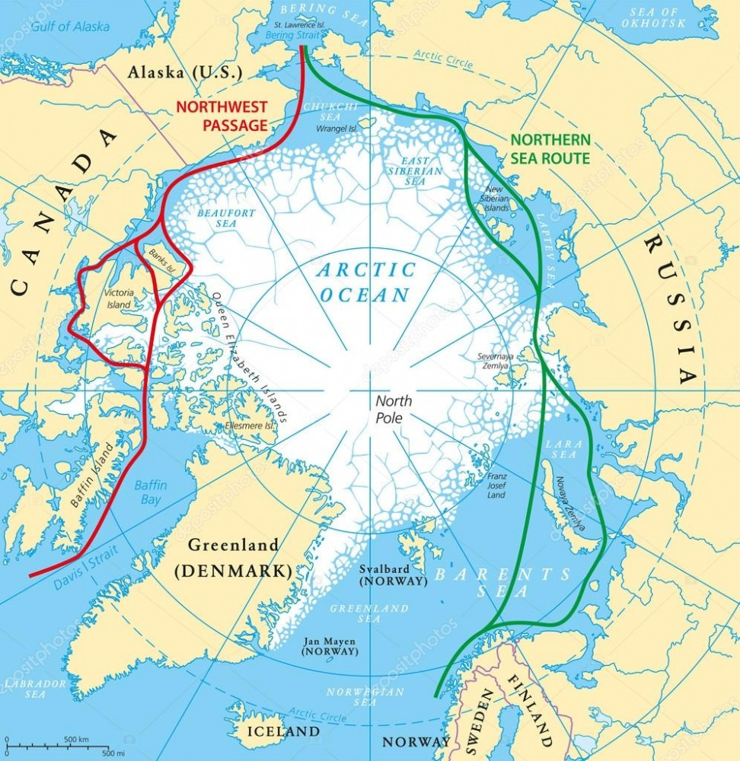
ARCTIC MARITIME TRANSPORT CORRIDORS
The driver of development of the Arctic shipping is transportation of the mineral resources got in the Arctic zone in Russia, Canada, Norway and the USA.
NSR: STRUCTURE OF THE ARCTIC FREIGHT TRAFFIC 1-3Q2018
2
Data sources: Ministry of transport; analysis by GECON
Notes:
181021 карта смп сзп October 21st, 2018 - Дмитрий Викторович Лобусов 911184_1000.jpg
Драйвером развития арктического судоходства является перевозка минеральных ресурсов, добываемых в Арктической зоне в России, Канаде, Норвегии и США.

Slide 3
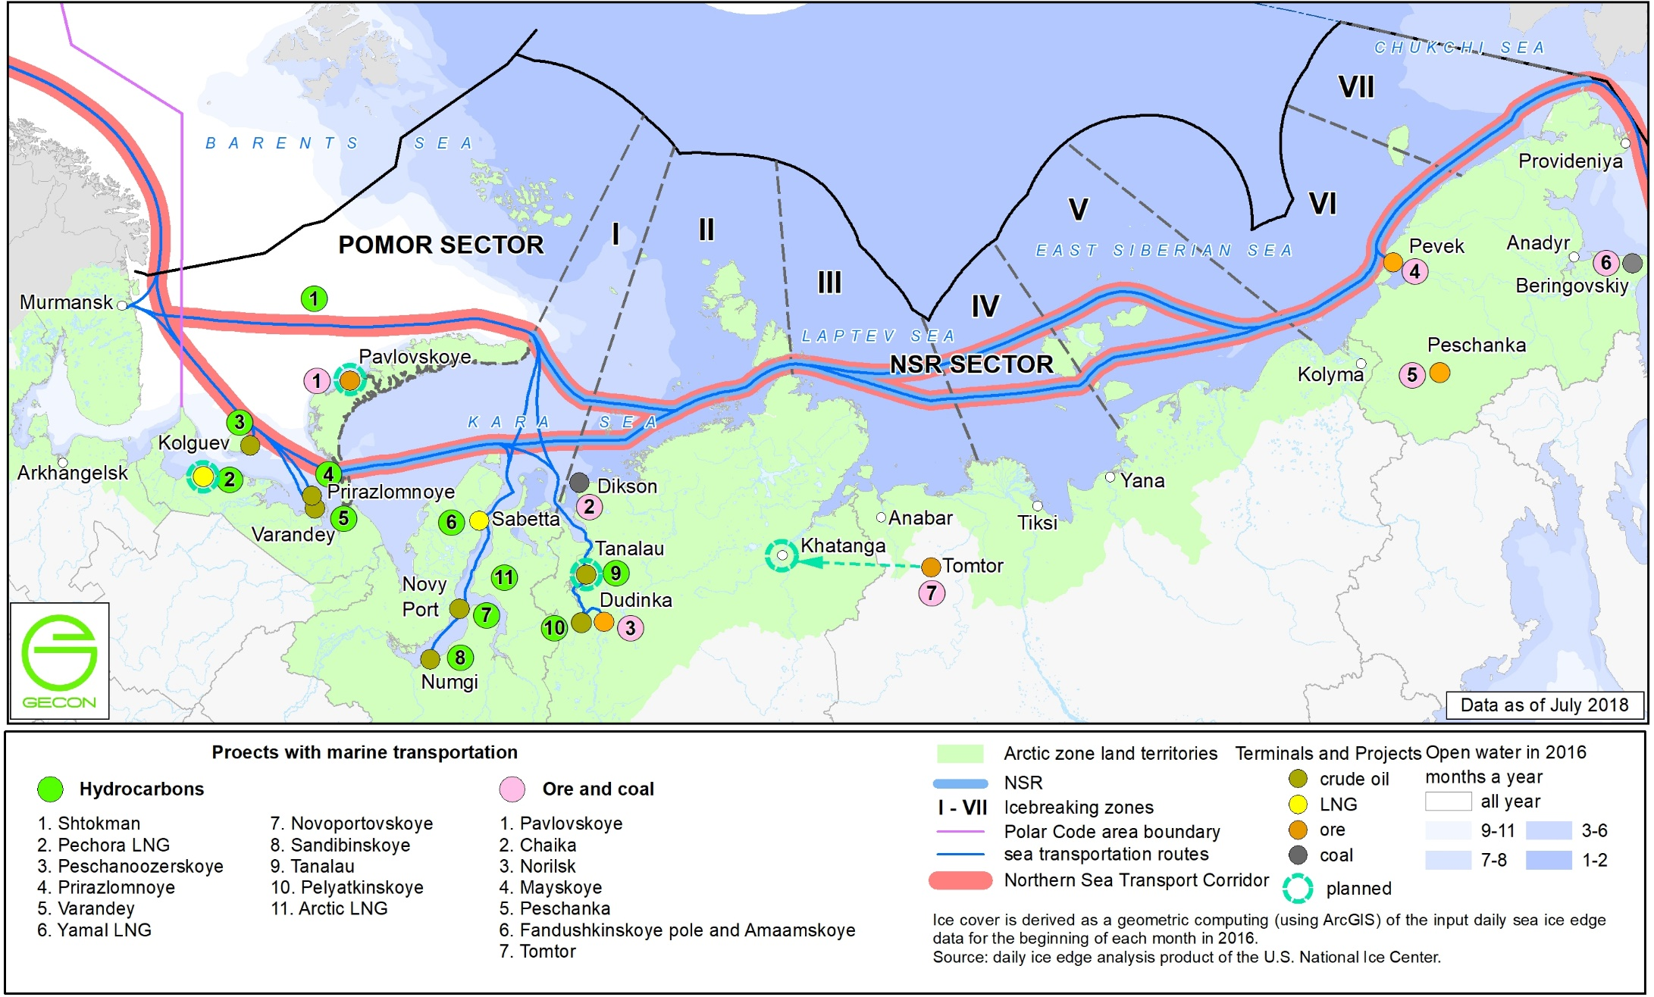
NORTHERN SEA TRANSPORT CORRIDOR ALIAS NORTHEAST PASSAGE
year-round navigation
3
Data sources: Ministry of transport, Ministry of natural resources, companies; analysis by GECON
Notes:
карта арк проекты увс тпи_номера_нет ЛУ_НОВ НАЗВ_англ_180709ЕС.jpg
Напоминает размеры танкеров – Индига и Маржери, см монтаж Лобусова

Slide 4
NORTHERN SEA ROUTE SHIPPING DEVELOPMENT
DYNAMICS OF FREIGHT TRAFFIC
ON THE NORTHERN SEA ROUTE
FORECAST OF THE FREIGHT TRAFFIC OF MINERAL RESOURCES ALONG THE NORTHERN SEA ROUTE
4
Data sources: Rosnedra, companies; analysis by GECON
Notes:
Прогноз грузопотока_ВИМС Комментарий МГ 180330 180410.xlsx Рис Прогноз грузопотока СМП Eng

Slide 5
ARCTIC SHIPPING BECOMES MORE INTERNATIONAL
5
Data sources: companies; analysis by GECON
Notes:
АТП Грузоперевозчики и верфи Совбез 170306 181031.xlsx Грузовые суда 181031 ENG

Slide 6
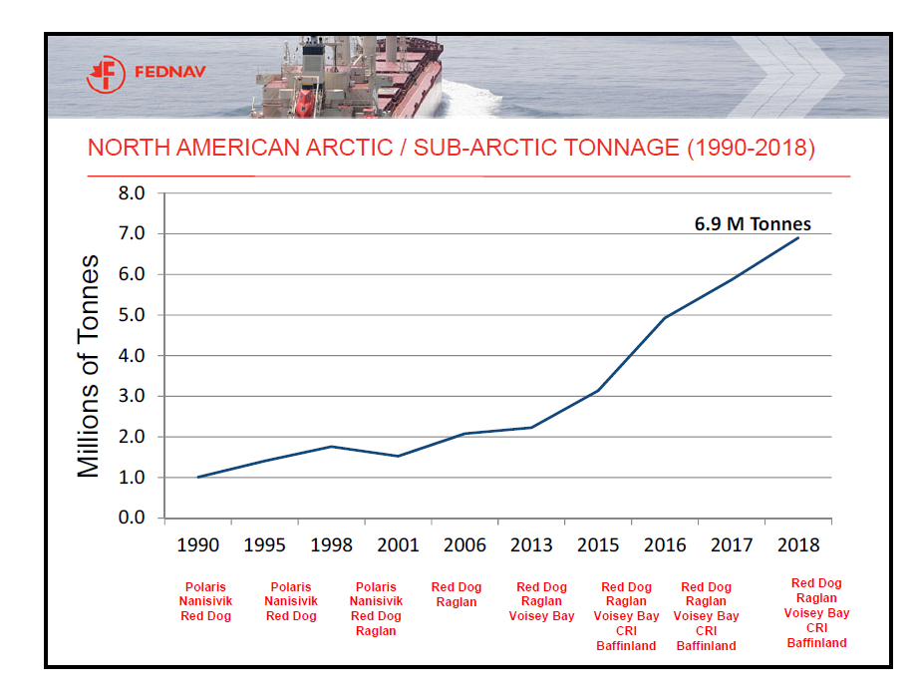
NORTHWEST PASSAGE. CANADA
FedNav - year-round export of ores and concentrates of nickel and copper from Nunavik Nickel, Raglan and Voisey's Bay projects by PC 4 vessels both on internal Canadian, and on world markets.
Baffinland Iron Mines Corporation. 2017 navigation (from August 2 to October 17, 75 days): 4.1 million tonnes of iron ore from its Milne Inlet Port shipped by Panamax to markets in Germany, the United Kingdom, and Japan.
6
Data sources: FedNav; analysis by GECON
Notes:
181021 карта смп сзп October 21st, 2018 - Дмитрий Викторович Лобусов 911184_1000.jpg

Slide 7
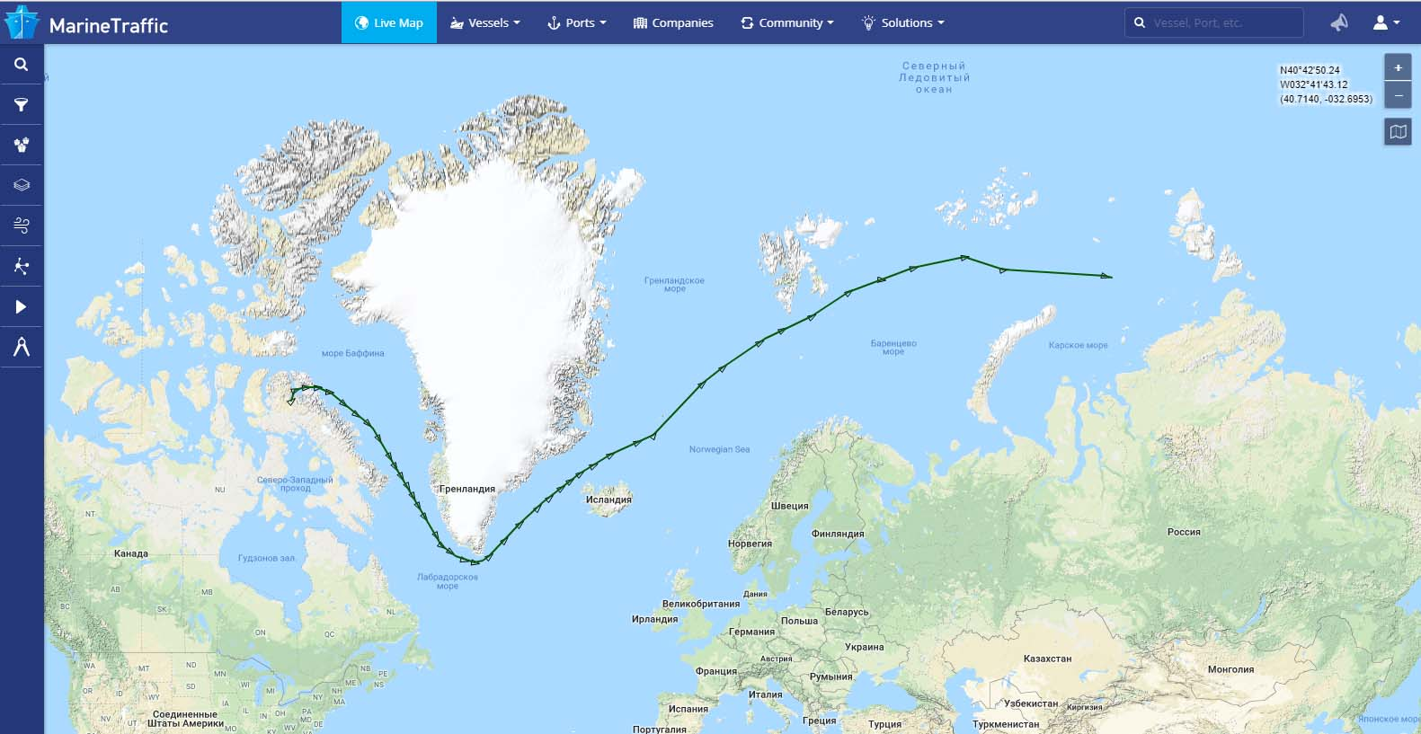
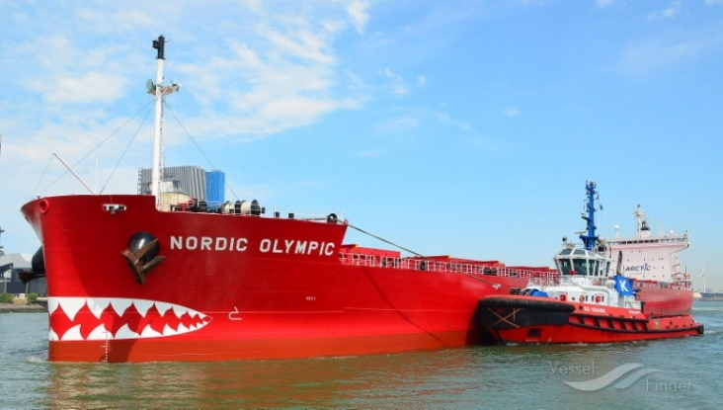
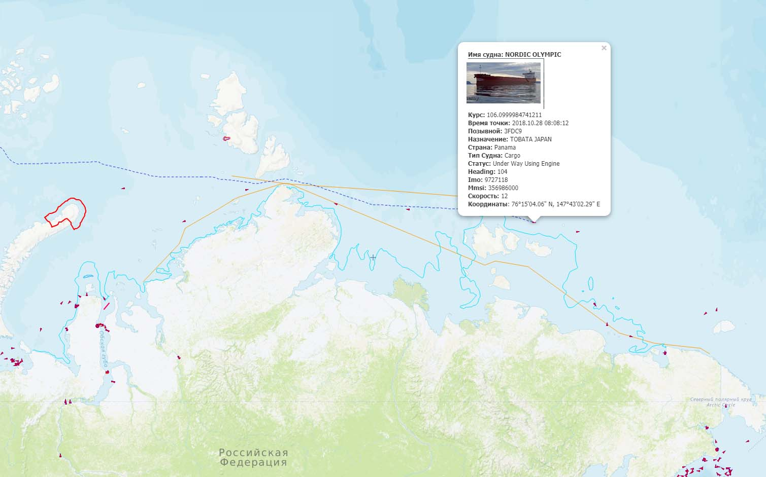
FROM THE NORTHWEST PASSAGE THROUGH NORTHEAST PASSAGE TO JAPAN
The Panamax NORDIC OLYMPIC bulker (ice class 1A = RMRS Arc 4) of the Nordic Bulk company (Denmark) with freight of iron ore of Baffinland Iron Mines Corporation moves from Milne Inlet (Canada) to Japan. Ship left port on October 8. The nuclear ice breaker YAMAL in East Siberian sea carries out conducting of the bulker on east edge of ices. ETA Tabata Japan – November 11.
7
Data sources: Baffinland Iron Mines, MarineTraffic, NSRA; analysis by GECON
Notes:
912876_original.jpg 181028 смп балкер канада October 28th, 2018 - Дмитрий Викторович Лобусов 912876_900.jpg NORDIC OLYMPIC 1.jpg
171018 Baffinland Iron Mines concludes record-setting shipping season with 4_1 million tonnes of iron ore shipped over 75 days Baffinland.mht Mary River Mine - Wikipedia 181031.mht
Балкер "NORDIC OLYMPIC" компании Nordic Bulk с грузом железной руды Baffinland Iron Mines Corporation следует из MILNE INLET (Канада) в Японию. Вышел из порта 8 октября. Атомный ледокол Ямал в Восточно-Сибирском осуществляет проводку балкера на восточную кромку льдов. ETA Tabata Japan – 11 of November.

Slide 8
Thank you for attention!
mgrigoriev@gecon.ru
© Gecon LLC, 2018 All rights reserved. Neither the whole nor any part of this document shall be reproduced in any form nor used in any manner without express prior permission from Gecon LLC and applicable acknowledgements. No trademark, copyright or other notice shall be altered or removed from any reproduction.

