Slide 1
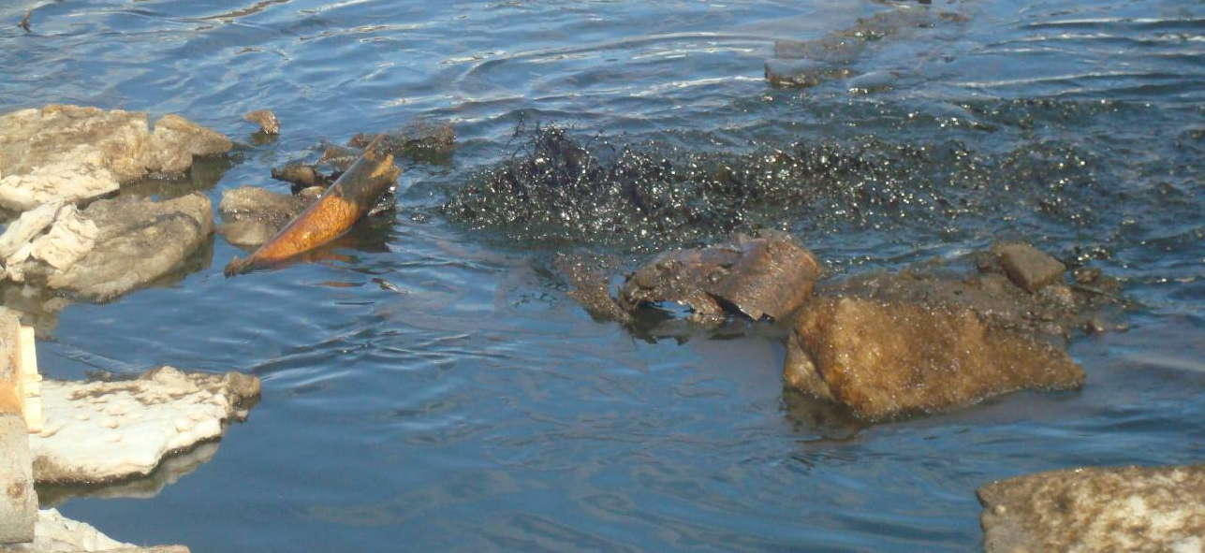
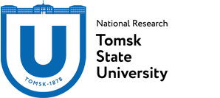
Aeroschup: technology for assessing and purifying sediments from oil and petroleum products of the northern territories
Danil S. Vorobiev
Dr. Sci. Biol. Director of the Biological Institute of TSU

Slide 2
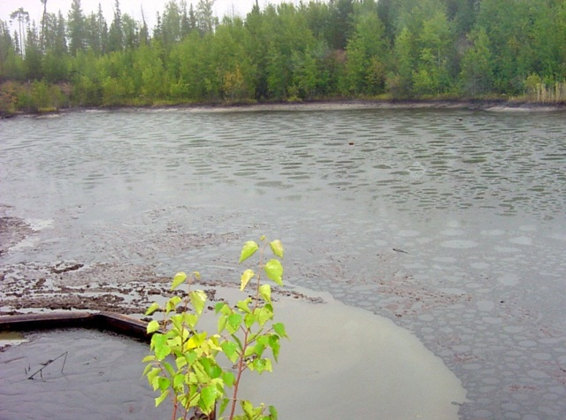
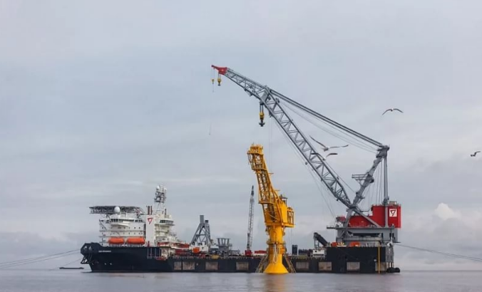
Why the issue of oil-contaminated of water bodies is urgent
Aeroschup: technology for assessing and purifying sediments from oil and petroleum products of the northern territories

Slide 3
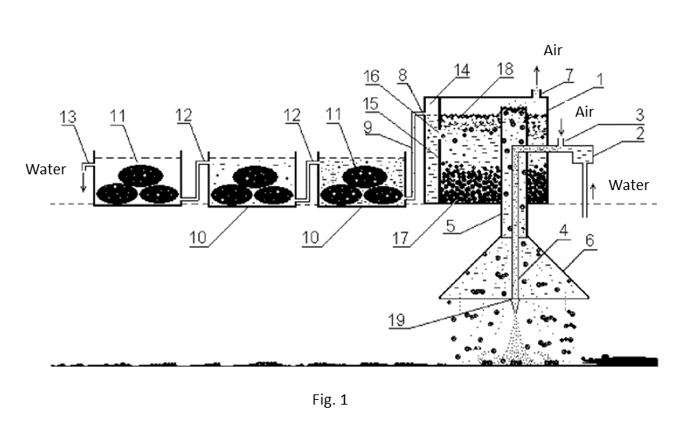
Oil lifting from bottom sediments
Laboratory facilities
Aeroschup: technology for assessing and purifying sediments from oil and petroleum products of the northern territories

Slide 4
Oil lifting from bottom sediments
Oil slick on the surface of the water body
Aeroschup: technology for assessing and purifying sediments from oil and petroleum products of the northern territories

Slide 5
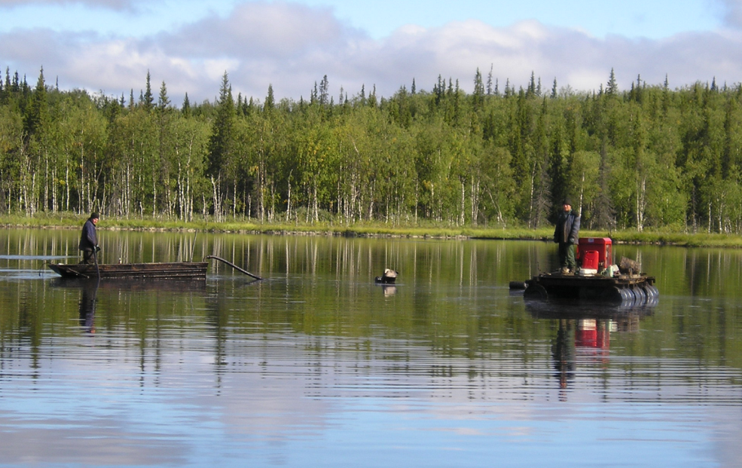
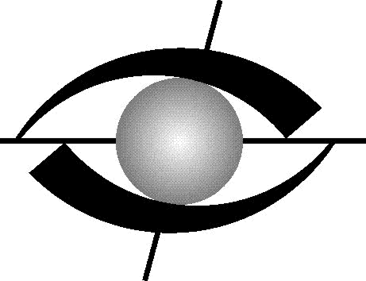
Aeroschup as a technology for purifying bottom sediments from oil and petroleum products (using the example of Subarctic regions)
2003-2007
The efficiency of the flotation process for purifying bottom sediments of water bodies from oil has been tested and proved in the Komi Republic and in Khanty-Mansiysk region (Russia)
Scientific and technical association
"PRIBORSERVICE"
Tomsk
Aeroschup: technology for assessing and purifying sediments from oil and petroleum products of the northern territories

Slide 6
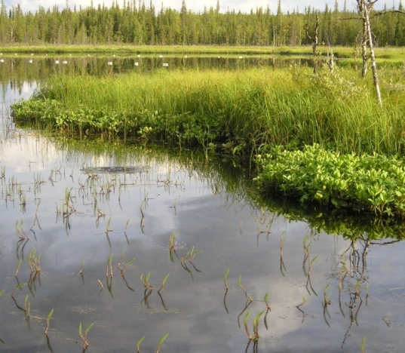
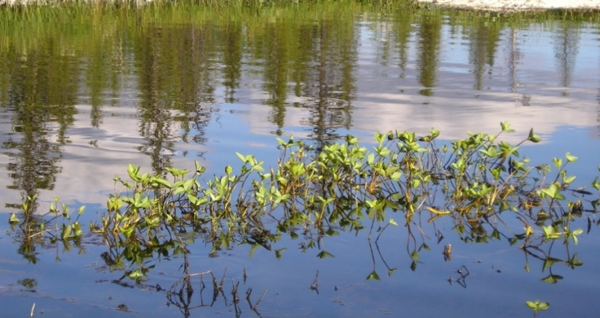
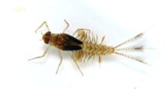
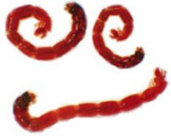
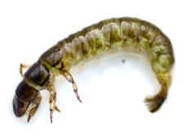
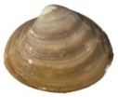
Results of experimental activities of purifying bottom sediments in the Komi Republic, 2004–2005
157
tons of oil
lifted from the bottom of the lake with an area of 6.4 hectares for 2 seasons of work (2004-2005)
12 meters
maximum depth of oil contamination
THE LAKE IS BEING ACTIVELY INHABITED BY HYDROBIONTS
Aeroschup: technology for assessing and purifying sediments from oil and petroleum products of the northern territories

Slide 7
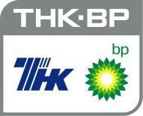
Results of experimental activities in Khanty-Mansiysk region– Ugra, 2006–2007
Share of oil (mg / kg)
Before purification
After purification
60 times
reduced oil content in flooded quarries
Aeroschup: technology for assessing and purifying sediments from oil and petroleum products of the northern territories

Slide 8
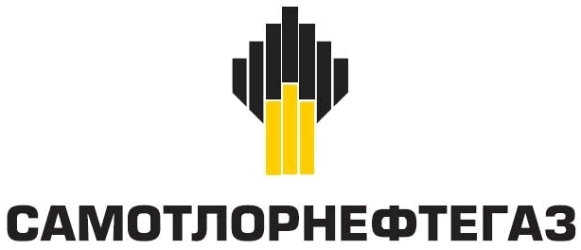
Project results at the lake in Khanty-Mansiysk region, 2018
101,7 g/kg
SAMOTLORNEFTEGAZ
50 times
reduced oil share
in the lake

Slide 9
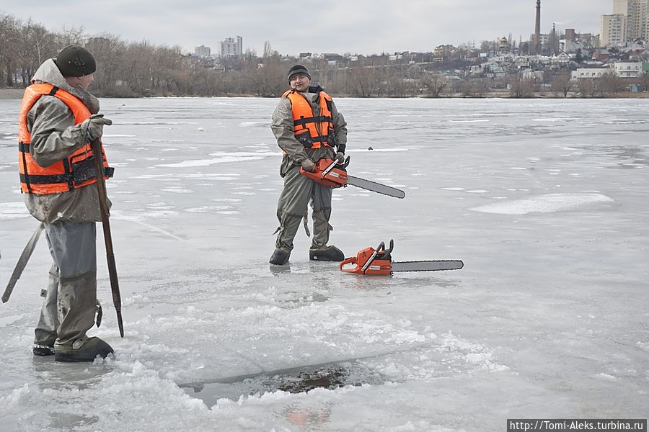
Purifying the bottom of water bodies from oil in winter period
ADVANTAGES
possibility to get to any water body
(winter roads)
minimumal impacts on the ecosystem
(low temperatures, lack of vegetation, minimal oil mobility)
Aeroschup: technology for assessing and purifying sediments from oil and petroleum products of the northern territories

Slide 10
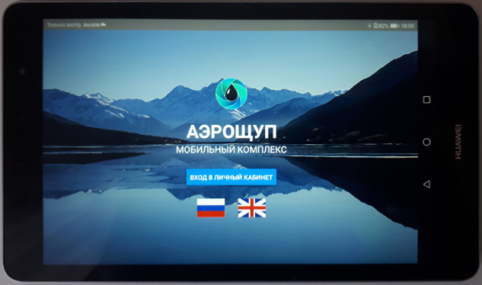
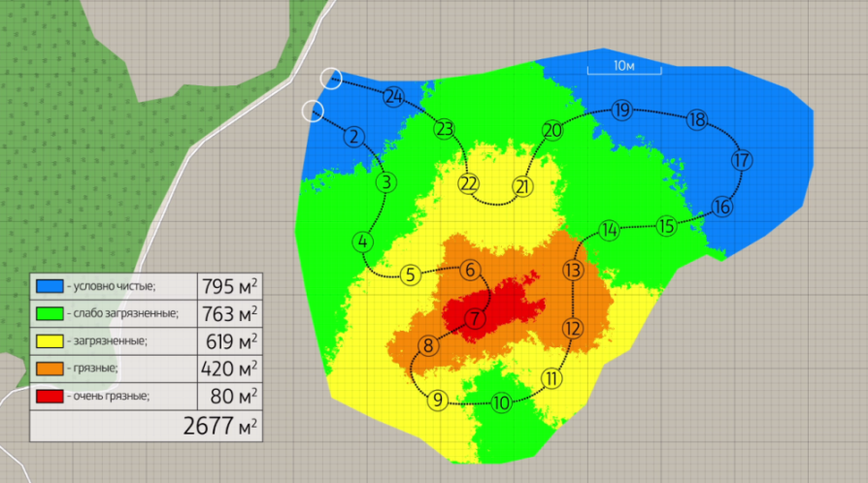
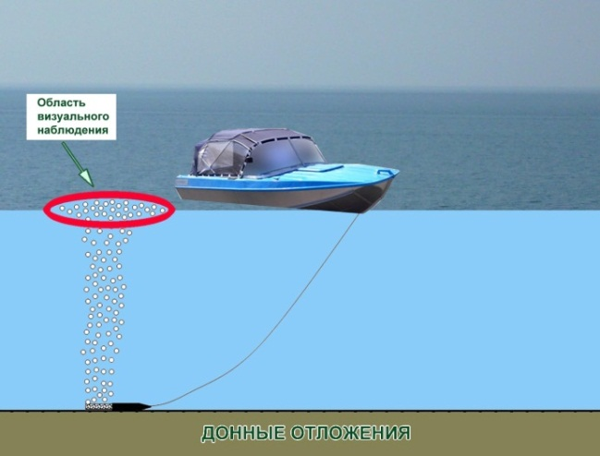
Algorithm of measurements (in assessing of the degree of contamination)
date and time
coordinates
degree of contamination
photofixation

Slide 11
Effects of the Aeroschup technology
express assessment of contamination of the bottom sediments
minimum costs of the inspection of water bodies
accuracy of mapping oil-contaminated bottom sediments
mobility
operational survey of large areas
=

Slide 12
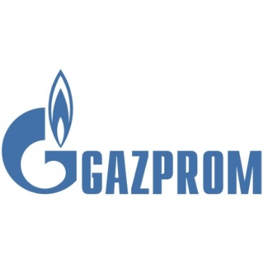
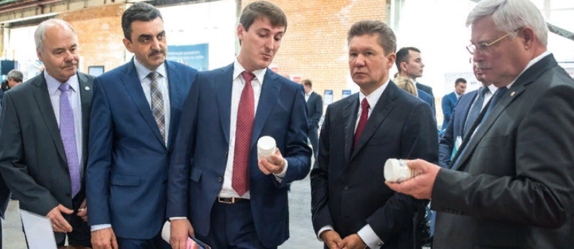
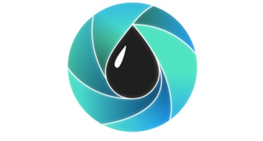
Technology is included in the Roadmap of interaction of Tomsk region with PJSC “Gazprom”
AEROSCHUP

Slide 13
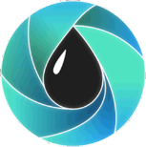
THANK YOU!
Danil Vorobiev
Dr.Biol.Sci
Director of Biological Institute
National Research Tomsk State University
+7 913 803 13 90
aeroschup.com

Slide 14
Ichthyological indicative assessment of purifying activities, lake Schuchie (the Komi Republic)
Anomalies in development of the maxillary apparatus of the pike

