Slide 1
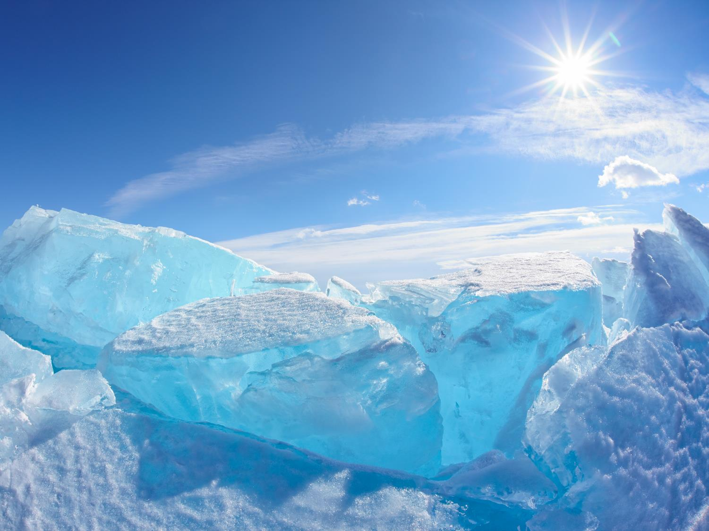

Arctic – platform for future development
Ian Colebourne, 01 – 03 October
TRANSTEC 2014

Slide 2
Contents
Arctic: region of unprecedented opportunities and challenge
Truly joint effort: Legal and Governance, Technology & Innovations, Finance, Oil & Gas sector, Transportation & Infrastructure, Environmental and Social Responsibility
Challenges to overcome: territorial ambiguity for the Arctic countries, investment and industrial development, environmental protection, resources competition
Opportunity: initiating truly integrated projects, including the Northern Sea Route, Russia has an historical chance to become a leader of the global initiative for the safe and sustainable development of the Arctic

Slide 3
Global challenges and stakeholders in the Arctic
Global challenges | Territorial ambiguity | Industrial development | Environmental issues
Most influential stakeholders | International organizations Countries Local communities Corporations | Corporations Countries Environmental groups & NGOs Local communities Think-tanks & expert communities | International organizations Countries Environmental groups & NGOs Corporations Local communities Think-tanks & expert communities
Systemic conflicts | Countries VS countries | Corporations VS corporations | Ecological NGOs & local communities VS corporations

Slide 4

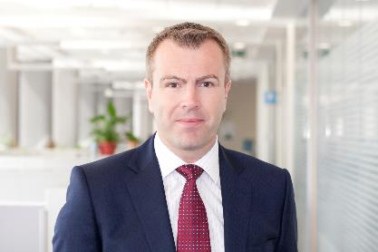
Ian Colebourne
Managing Partner,
CEO-elect Russia and CIS
Deloitte & Touche CIS
icolebourne@deloitte.ru
+7 (495) 787 06 00
www.deloitte.ru

